Slide 1
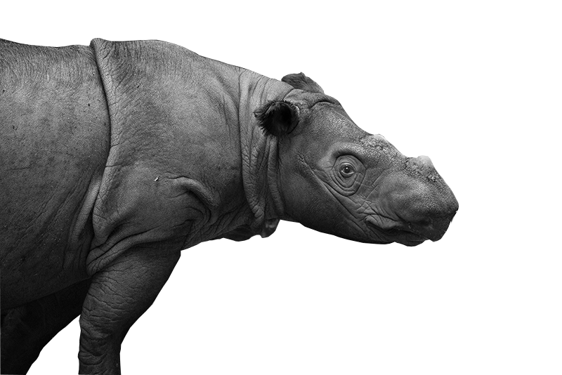
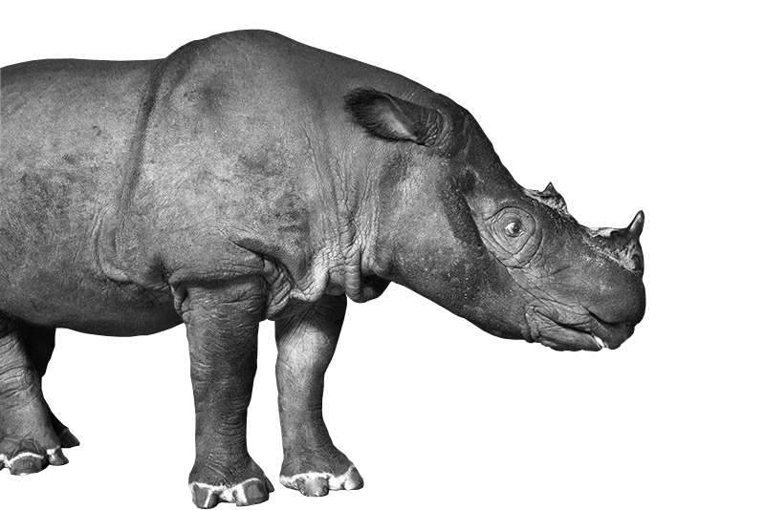
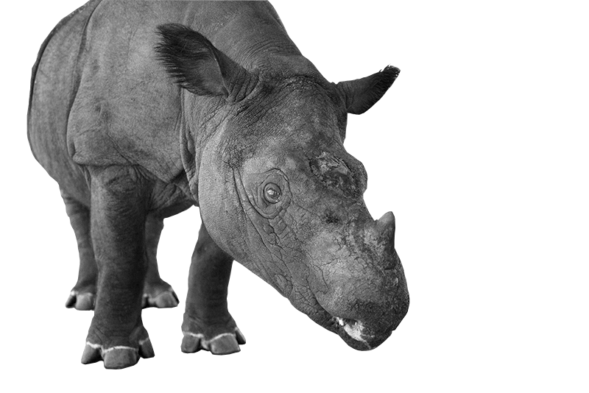
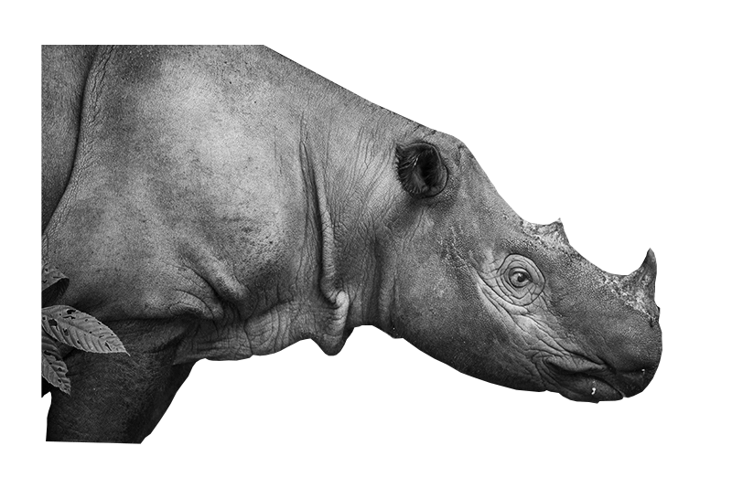
Rhino Sync
Problem Statement 8
A web platform for you to self-identify
your own personality traits
and discover your ‘inner Sumatran rhino
Team Eden
Arsen Tumwesigye | Arthur Kasirye | Cerinah Nalwoga | Fanny Nyayic

Slide 2
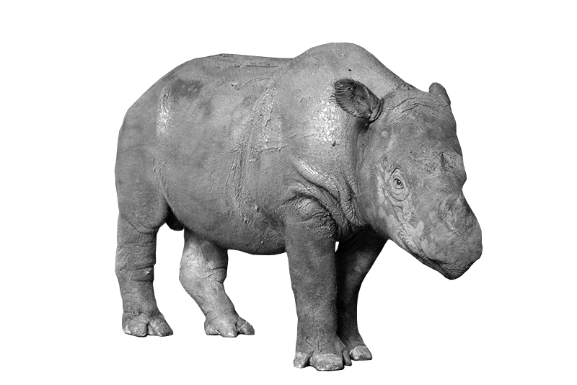
https://www.rhinosync.com

Slide 3







Thank you

